Slide 1
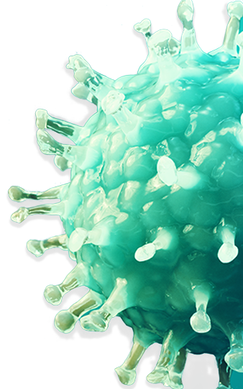


HIV-1 Learning Program
Module 1: Biology and Pathology of HIV
For Internal Use Only. Not To Be Distributed or Used Outside of the Company. US-DOR-01355. 04/24.

Slide 2




Table of Contents
Abbreviations
Introduction and Learning Objectives
Biology and Pathology of HIV
Glossary Terms

Slide 3

Abbreviations
A
R
T
Antiretroviral Therapy
C
D
C
Centers for Disease Control and Prevention
H
I
V
Human immunodeficiency virus
P
r
E
P
Pre-exposure prophylaxis

Slide 4





Introduction
In this mini-module, you will learn basic principles about the biology of and pathology caused by the human immunodeficiency virus (HIV). The goal of this resource is to provide you with basic background information and perspectives about the history of the HIV epidemic; including the structure, transmission, classification, and replication cycle of HIV; and how this virus targets and destroys immune cells.
Learning Objectives
At the end of this module, you should be able to:
Outline the history of the HIV epidemic
Understand the basic differences between viruses and bacteria
Explain how HIV is transmitted and classified
Describe the HIV structure and replication cycle
Review the concept of “HIV reservoirs”
Discuss the mechanisms by which HIV targets and kills CD4+ cells

Slide 5




The Continuum of Care
The most effective way to help reduce HIV-related morbidity and mortality is to ensure continuous care…
…which means that people living with diagnosed HIV infection (PLWH) need to:
ART has transformed HIV into a manageable chronic condition, with life expectancy approaching that for people without HIV.
Be diagnosed as early as possible
Be prescribed antiretroviral therapy (ART)
Guidelines for the Use of Antiretroviral Agents in Adults and Adolescents with HIV
Be linked to care with a heath care provider as soon as possible after diagnosis
Achieve and maintain viral suppression (HIV viral load undetectable)
Prevalence represents the number or proportion of people with a particular disease or condition in a given population and at a specific time.
Be engaged or retained in care
Incidence represents the number of new cases of a condition, symptom, death, or injury that develops in a specific area during a specific time period.
The HIV Undetectable=Untransmittable (U=U) concept means that PLWH who consistently maintain an undetectable viral load- indicating extremely low levels of HIV in their blood-by adhering to a daily regimen of antiretroviral therapy (ART) cannot sexually transmit the virus to others.

Slide 6






The HIV Epidemic Highlights: 1980s and 1990s
FDA approves Combivir, a combination of 2 antiretroviral drugs in one tablet
CDC uses the term “AIDS” and releases the first case definition
FDA approves first antiretroviral drug, zidovudine (AZT)
1982
1987
1997
1981
1986
1995
First official reporting of AIDS cases
Virus that causes AIDS officially known as HIV
FDA approves first protease inhibitor (saquinavir)

Slide 7






The HIV Epidemic Highlights: 2000–Present
FDA approves the first fixed-dose combination of 3 antiretroviral drugs (Atripla)
WHO and UNAIDS issue healthcare-initiated HIV testing
CDC publishes updated HIV guidelines for pre-exposure prophylaxis to increase use among all people who could benefit
WHO call all PLWH to begin ART as soon as diagnosis
2006
2007
2015
2021
2001
2012
2018
2023
The Doha declaration affirms the rights of countries with limited resources to buy or manufacture generic medications
FDA approves the first HIV medication for PrEP
Evidence supports that maintaining undetectable levels of HIV with ART reduces chances of sexual transmission. This led to the “Undetectable= Untransmittable” (U=U)
Evidence shows that long-acting injectable ART may improve viral suppression outcomes for people experiencing challenges taking a daily HIV treatment pill

Slide 8





Summary of the HIV Epidemic in the US and Dependent Areas*
Estimated HIV Infections in 2021, By Region
According to the CDC in 2021*:
Estimated number of HIV diagnoses (incidence)
WEST (including Hawaii and Alaska)
21%
N=6,600
MIDWEST
14%
N=4,400
NORTHEAST
14%
N=4,400
32,100
Men accounted for the majority (81%) of these estimated infections
Change in 2021 vs. 2017 in key groups*:
SOUTH
52%
N=16,700
52% of
HIV diagnoses
in 2021 were
in the South
Increase:
- American Indian/Alaska Native (+16%)
- Native Hawaiian/other Pacific Islanders (+55%)
Decrease:
- Asian (-19%)
- Black/African American (-10%)
- White (-5%)
- Multiracial (-32%)
*Among people aged 13 and older
Data source: Center for Disease Control and Prevention

Slide 9





Impact of ART on Morbidity and Mortality Due to Advanced HIV Infection
ART helps…
…But more can be done
18
Trends in Annual Age-Adjusted Rates of Death caused by HIV in the US population (1987−2021)*
In the US in 2021 among persons ≥13 years of age:
16
An estimated 1.2 million had HIV (prevalence)
14
75% of people living with HIV received some HIV care.
After rapidly increasing since the 1980s, the annual rate of death due to HIV disease peaked around 1994, then decreased rapidly through 1997.
12
10
The Ending the HIV Epidemic in the US (EHE) initiative has set a target that by 2025...
Comparative statistics from 2021…
Deaths, Rate
(per 100,000 population)
8
At least 95% of all people living with HIV should know their HIV status.
87% knew their status
6
Introduction of HAART (1995)
At least 95% of all people diagnosed with HIV should achieve viral suppression.
66% achieved viral suppression
4
2
At least 50% of all people who would benefit from pre-exposure prophylaxis will receive it.
30% received PrEP ART
0
1987
1990
1993
1996
1999
2002
2005
2008
2011
2014
2017
2020
Year of death
*Adjusted graph from the CDC: Data from CDC WONDER Online Database
HAART, highly active antiretroviral therapy

Slide 10
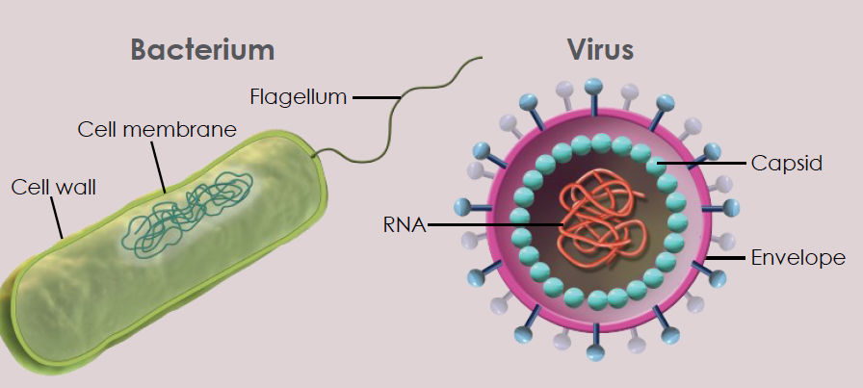
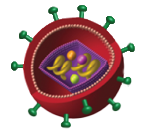
Viruses as Pathogens
Differences between viruses and bacteria:
  Unlike bacteria, viruses are not cells with a cell membrane surrounded by a cell wall. Viruses consist of nucleic acid molecules (either DNA or RNA) surrounded by a protein coat called a capsid and sometimes an envelope composed of phospholipid and protein made from the host’s cell membrane.
  Whereas most bacteria can survive and reproduce outside a host cell in appropriate conditions, viruses can multiply only inside host cells. Because of their absolute dependence upon host cells for their existence and eventual reproduction.
  Viruses infect host cells and use the host cell’s cellular machinery to replicate. Some viruses kill the host cell, some (like chicken pox) “hide out” in the host cell and replicate only once in a while, and others (like HIV) incorporate their DNA into that of the host cell.
  Although antibiotics can kill or inhibit bacteria, these agents are not effective in killing viruses. Some viruses, however, can be inhibited with specific antiviral drugs.
Bacteria and viruses can both cause disease in humans. While bacteria are single-celled microorganisms, viruses are microscopic infectious agents that requires a living host cell in order to replicate.
Representation of a Bacterium and an HIV Virus*
HIV virus
Differences between Viruses and Bacteria
 | Viruses | Bacteria
Structure | Acellular: Consist of nucleic acid core enclosed in a coat of proteins | Cellular, often with a cell wall
Life-cycle requirements | Parasitic: Require host cells to survive and replicate | Most are capable of surviving and reproducing without a host
Drug susceptibility | Cannot be killed by antibiotics: Some can be inhibited with antiviral drugs | Most can be inhibited or destroyed with antibiotics
*Representations are not to scale
Image sources: National institute of Health HIV glossary and Ghattas M, et al. Vaccines (Basel). 2021;9(12):1490.

Slide 11







HIV Transmission
HIV IS NOT TRANSMITTED BY
HIV can be found in body fluids, which include blood, semen, pre-seminal fluid, vaginal fluid, rectal fluid, and breast milk.
These fluids must come in contact with a mucous membrane or damaged tissue or be directly injected into the bloodstream.
Mucous membranes are found inside the rectum, vagina, penis, and mouth.
Saliva, sweat, tears, or closed-mouth kissing
Air or touch
Ways HIV can be transmitted*:
Sharing toilets or food
Insects
Condomless vaginal or anal intercourse with someone who is living with HIV
The US blood supply and donated organs and tissues are thoroughly tested. It is very unlikely to transmit HIV from blood transfusions, blood products, or organ and tissue transplants.
Shared needles, syringes, or other drug injection equipment with someone who has HIV
Since the 1990s in the US and dependent areas, advances in HIV research, prevention, and treatment have resulted in a decline of more than 95% in the diagnosis of perinatal HIV.
Perinatal transmission of HIV is possible during pregnancy, birth, or breastfeeding
*The higher someone’s viral load, the more likely that person is to transmit HIV.

Slide 12
HIV Transmission, continued
Differences in Estimated HIV Infections by Transmission Category* (2021)
Differences in Estimated HIV Infections by Age (2021)
4%
19%
8%
9%
22%
N=32,100
11%
N=32,100
Male-male sexual contact
13 to 24
Heterosexual contact
25 to 34
Injection drug use
21%
35 to 44
Male-male sexual contact
and injection drug use
45 to 54
>55
66%
*Among people aged 13 and older.
39%
Percentage of total population
(N=32,100)
No. of affected individuals
Differences in Estimated HIV Infections by Race/Ethnicity*, † (2021)
Black/African American
40%
13,000
9,300
8200
890
470
190
Hispanic/Latino‡
29%
White
26%
* Among people aged 13 and older.
† Data for Native Hawaiian and other Pacific Islander are not included because estimates are too small to report.
‡ Hispanic/Latino people can be of any race.
Multiracial
3%
Asian
1%
American Indian/Alaska Native
1%
Source: CDC. Estimated HIV incidence and prevalence in the United States 2017–2021. HIV Surveillance Supplemental Report 2023;28(3).

Slide 13
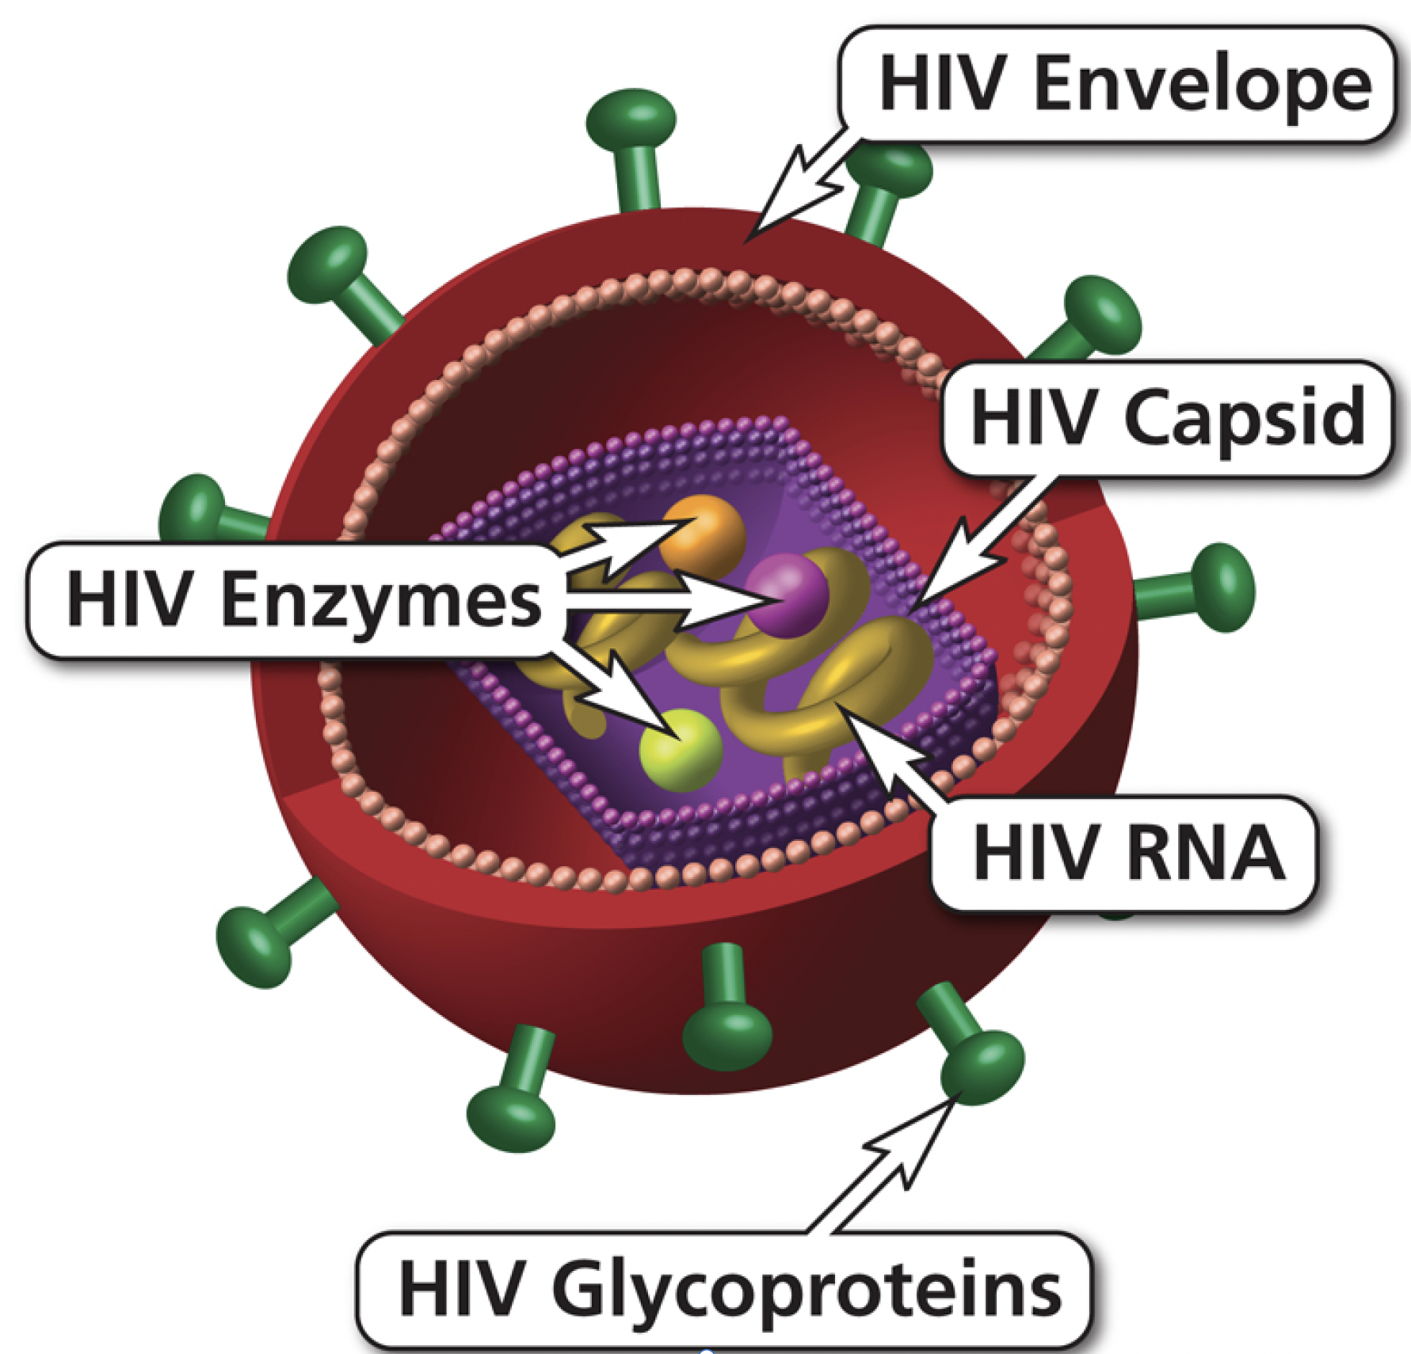
HIV Is an Enveloped Retrovirus
The Structure of HIV
HIV is an enveloped virus that is able to enter and replicate within cells of the immune system.
The HIV viral envelope protein binds to the host cell via membrane-embedded glycoproteins, including glycoprotein 120 (gp120) and glycoprotein 41 (gp41). To enter host cell, gp120/gp40 complexes bind to the cell-surface of CD4 cell.
Each complete virus particle,
called a virion, contains the
viral core, or capsid, which
contains two copies of an
RNA genome, each with
a complete copy of the virus’s
genes, and numerous copies
of the essential enzymes
necessary for infection of the
host cell.
Three enzymes in the capsid—
integrase, reverse
transcriptase, and
protease—carry out later
steps in the virus’s life cycle.

Slide 14
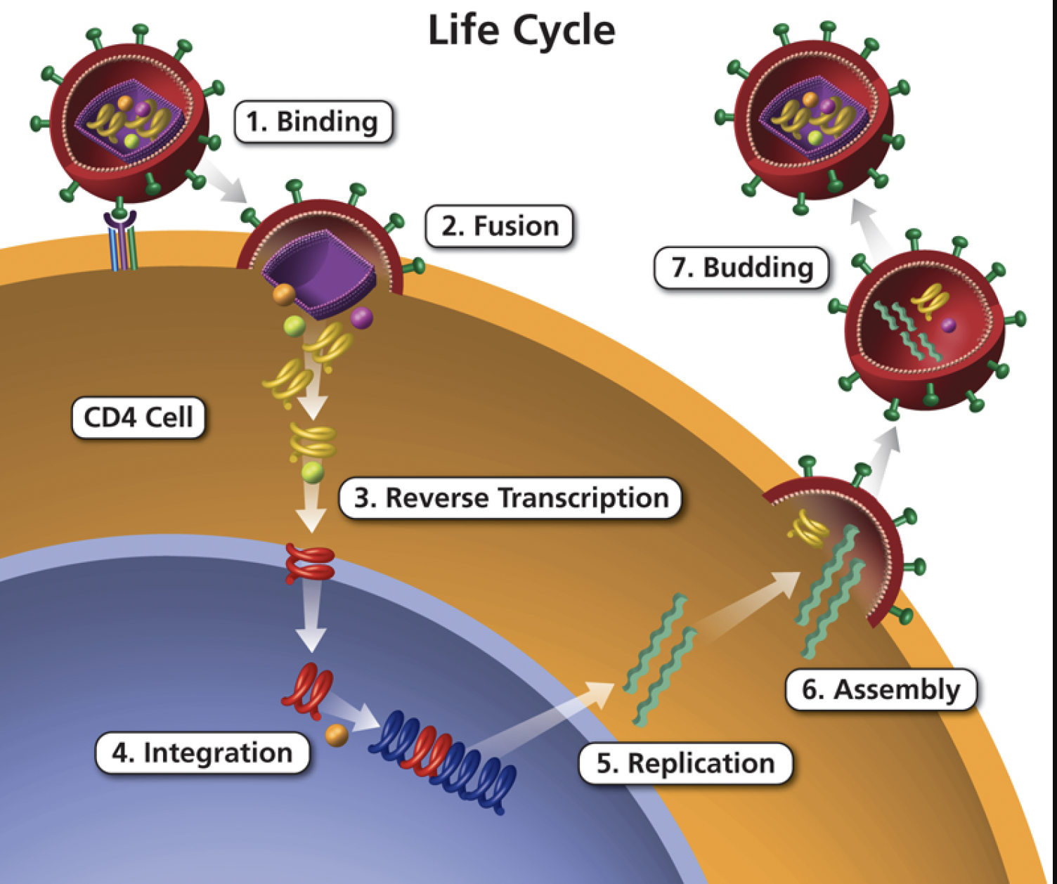
HIV Life Cycle
Replication of HIV
Mature HIV
CD4 receptors
HIV enzymes
Protease
The following section will look at each stage of the HIV replication cycle
HIV RNA
CD4 cell membrane
Immature HIV
Reverse transcriptase
HIV RNA
HIV DNA
CD4 cell nucleus
HIV proteins
HIV DNA
Integrase
CD4 cell DNA

Slide 15
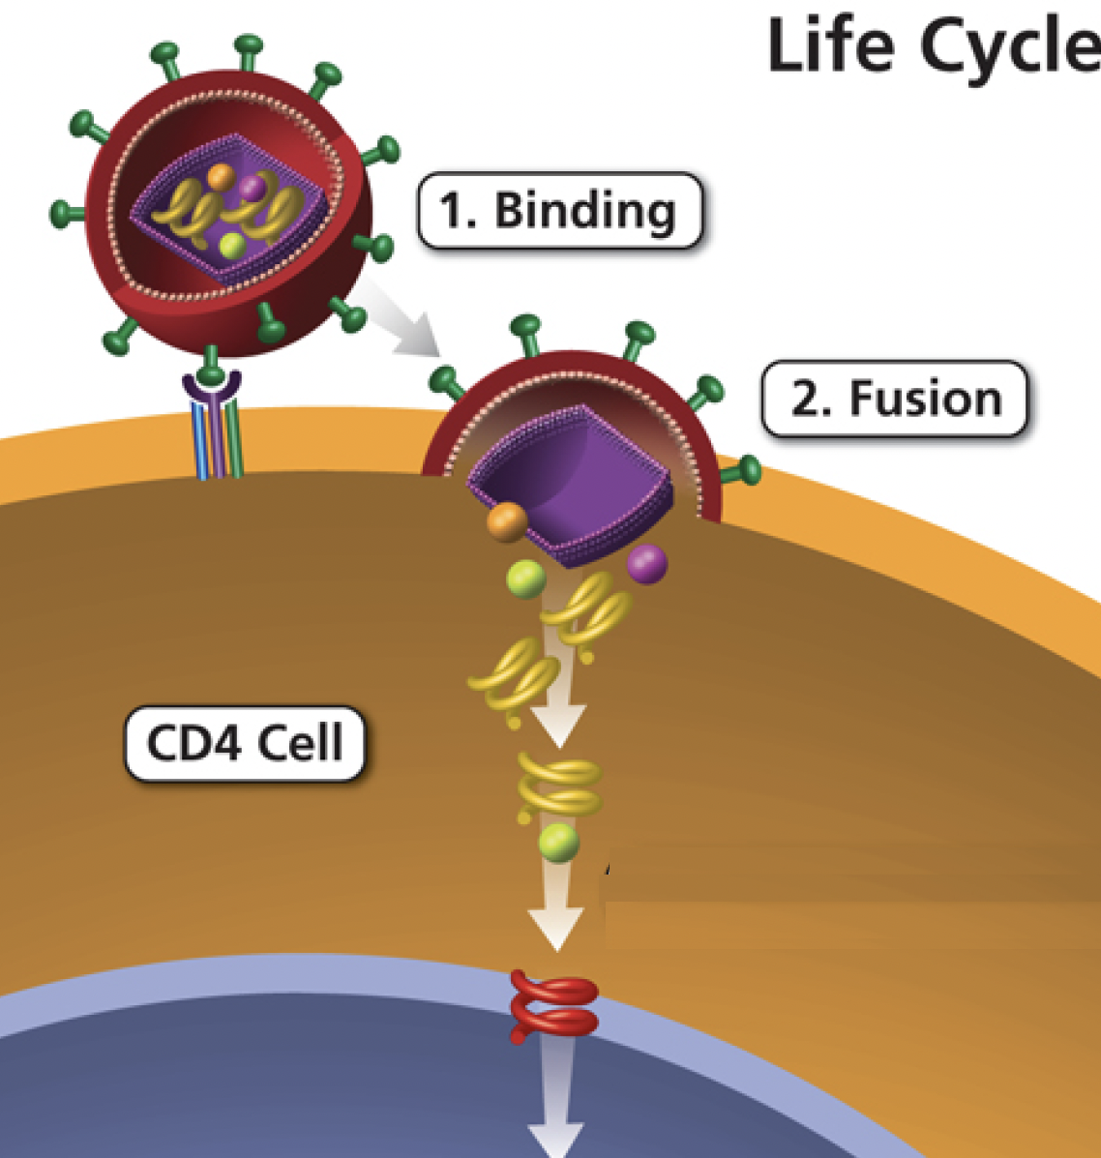
Replication Cycle of HIV: Attachment, Fusion, and Entry
HIV replication is carried out mainly in infected CD4+ cells (also called CD4 cells). These are specialized cells that help the body fight infections.
After HIV infects a CD4 cell, the virus goes through a series of steps to reproduce itself and create more virus particles.
CD4 receptors
1. Binding: The cycle begins when the HIV virus binds to CD4 and a co-receptor on the surface of the CD4 cell.
HIV enzymes
CD4 cell membrane
2. Fusion: Once attached to the co-receptor, the HIV viral envelope fuses with the cell membrane, allowing HIV to enter the cell. Once inside the CD4 cell, the virus releases HIV RNA and HIV enzymes, such as reverse transcriptase and integrase.
HIV RNA
Reverse transcriptase
WHY THIS IS IMPORTANT
HIV DNA
Understanding the life cycle of HIV is important because ART targets different steps of the viral life cycle.
CD4 cell nucleus

Slide 16
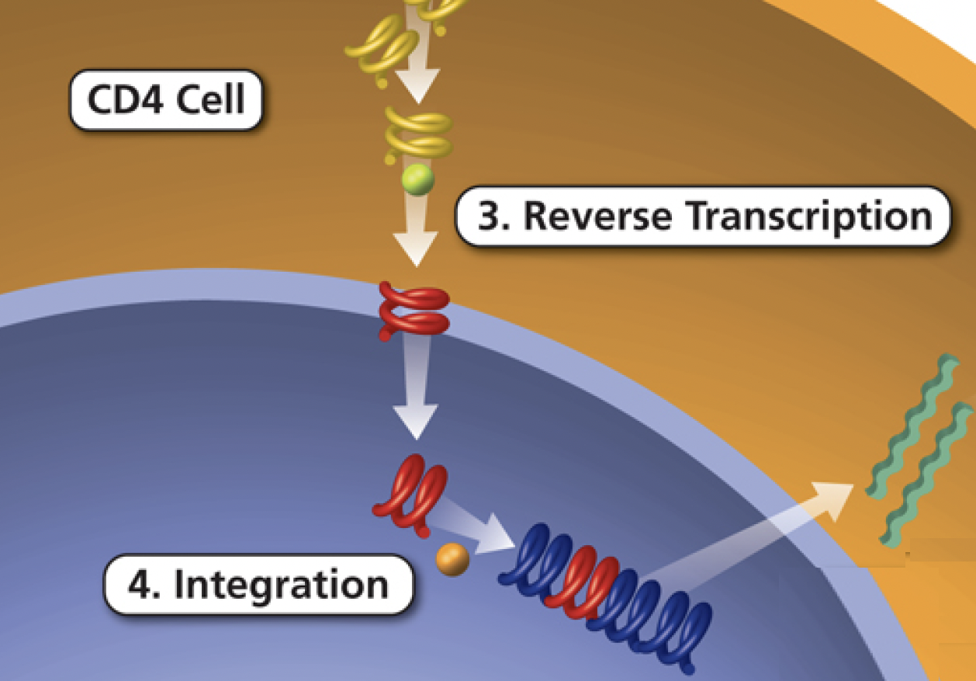
Replication Cycle of HIV: Reverse Transcription and Integration
3. Reverse Transcription: HIV releases and uses reverse transcriptase, an HIV enzyme, to convert its genetic material (HIV RNA) into HIV DNA. This allows HIV to enter the CD4 cell nucleus and combine with the cell’s genetic material (DNA).
HIV RNA
Reverse transcriptase
HIV DNA
CD4 cell nucleus
HIV proteins
4. Integration: Once inside the CD4 cell nucleus, HIV releases an enzyme called integrase. HIV uses integrase to insert its viral DNA into the DNA of the host cell.
HIV DNA
Integrase
CD4 cell DNA

Slide 17
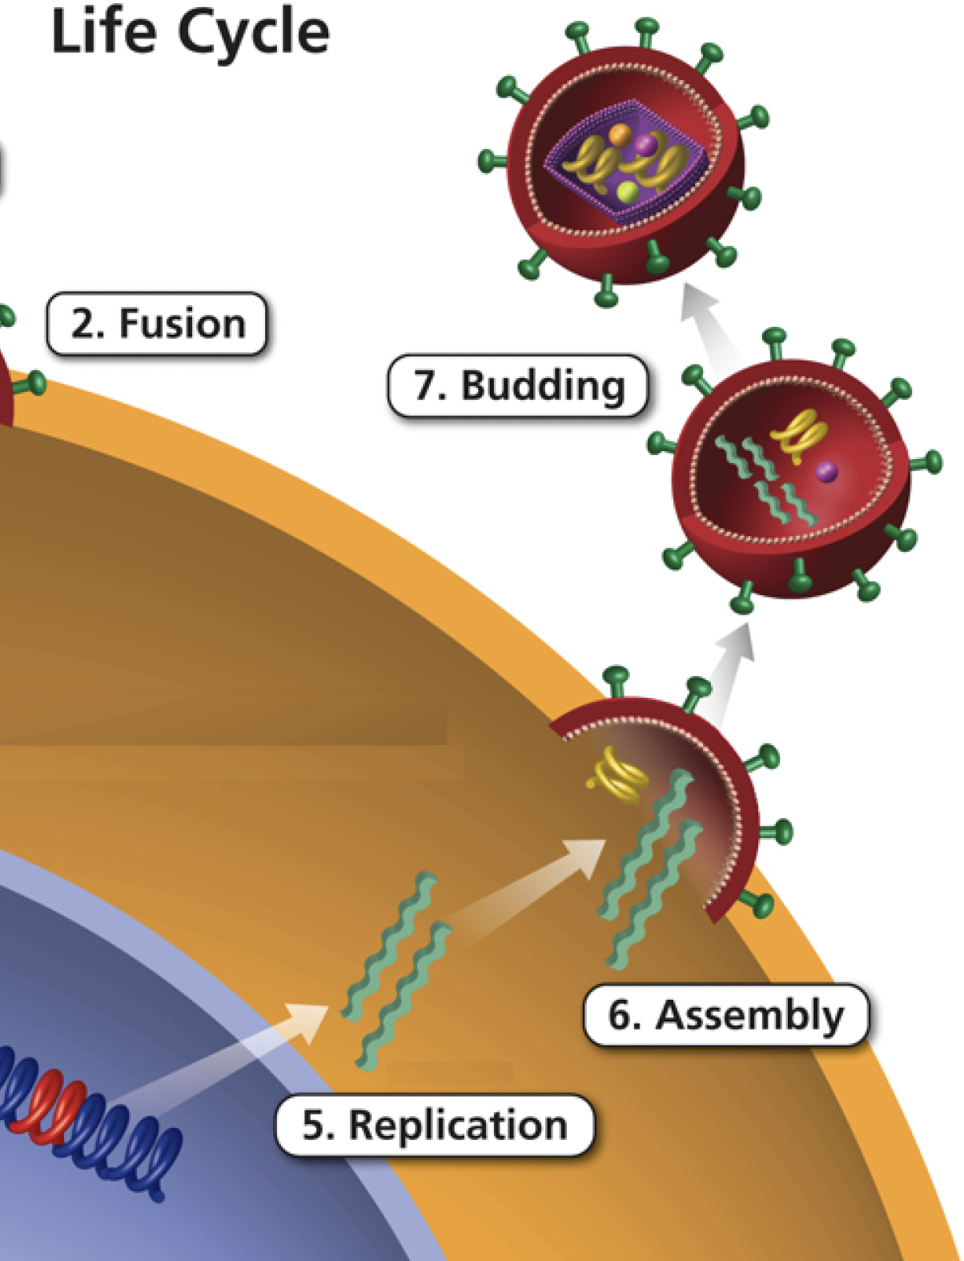


Replication Cycle of HIV: Replication, Assembly, and Budding
5. Replication: Once integrated into the CD4 cell DNA, HIV begins to use the cell’s machinery to make long chains of HIV proteins. These protein chains are the building blocks for more HIV.
Mature HIV
6. Assembly: New HIV proteins and HIV RNA made by the host CD4 cell move to the surface of the cell and assemble into immature, non-infectious virus particles.
Protease
CD4 cell membrane
Immature HIV
7. Budding and maturation: During budding, immature HIV (noninfectious HIV that cannot infect another CD4 cell) pushes itself out of the host CD4 cell. Once outside the CD4 cell, the virus releases protease, an HIV enzyme. Protease breaks up the long protein chains in the immature virus, creating the mature (infectious) virus.
HIV RNA
HIV proteins
CD4 cell nucleus

Slide 18
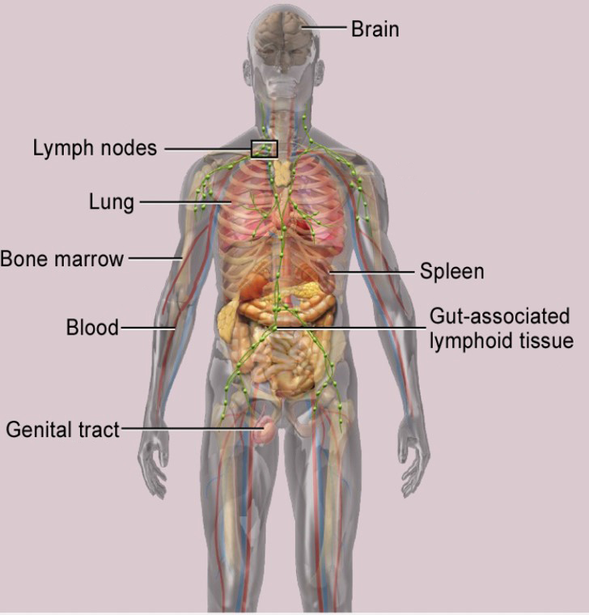
HIV Reservoirs
HIV Reservoirs
As you have learned, HIV infects the body’s immune cells (CD4 cells) and uses these cells’ machinery to replicate.
Latent HIV reservoirs are composed of resting CD4 cells (or other cells) that are infected with HIV but not actively producing HIV.
Latent HIV reservoirs are established during the earliest stage of HIV infection.
Although antiretroviral therapy (ART) can reduce the level of HIV in the blood to an undetectable level, latent reservoirs of HIV continue to survive.
When a latently infected cell is reactivated, the cell begins to produce HIV again.
WHY THIS IS IMPORTANT
ART can help suppress HIV levels but cannot eliminate latent HIV reservoirs and therefore cannot cure HIV infection.

Slide 19
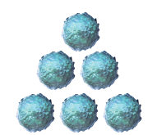
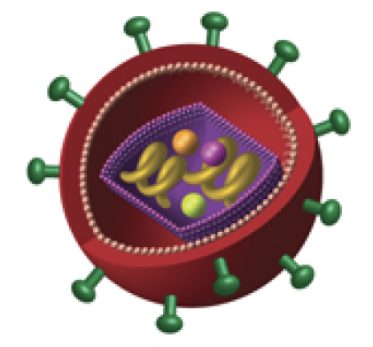
HIV Pathogenesis
In the absence of treatment, HIV infection is characterized by a progressive loss of CD4 cells.
CD4 count is a laboratory test that measures the number of CD4 T lymphocytes (CD4 cells) in a sample of blood. In people with HIV, the CD4 count is the most important laboratory indicator of immune function and the strongest predictor of HIV progression. The CD4 count is used to monitor a person’s response to antiretroviral therapy (ART).
For most patients on therapy, an adequate response is defined as an increase in CD4 count in the range of 50 cells/mm³ to 150 cells/mm³ in the first year of ART, generally with an accelerated response in the first 3 months of treatment.
A lower viral load means that fewer HIV particles are in the blood.
CD4 cells
HIV
WHY THIS IS IMPORTANT
The more CD4 cells you have in your body, the better your immune system will be.
CD4 count is useful before initiation of ART to establish the need for the initiation of opportunistic infection (OI) prophylaxis and to assess the urgency to initiate ART; and after ART to assess immunologic response and to establish the need for discontinuation of OI prophylaxis.

Slide 20
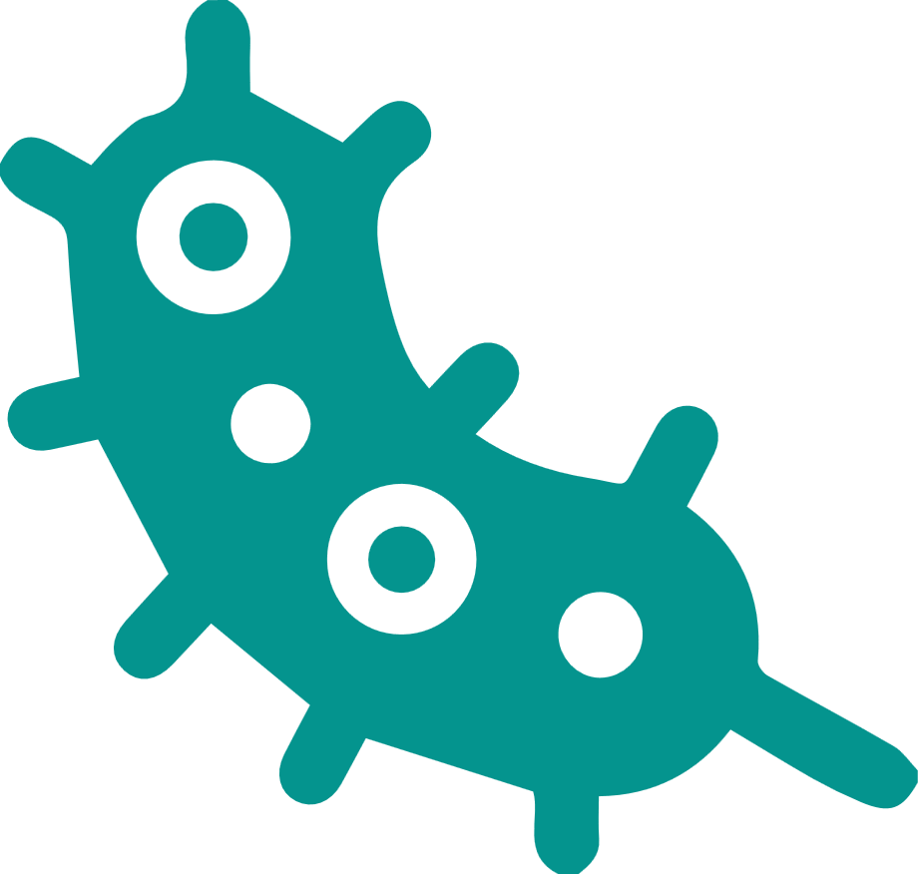








Glossary Terms
Word | Definition
Bacterium | A single-celled microorganism that occurs naturally almost everywhere on earth, including in humans.
Capsid | The core section of HIV that contains the genetic information (two single strands of RNA) and three enzymes needed for HIV to replicate.
CD4+ Cell | Also known as CD4 T Cell, is a type of lymphocyte that helps coordinate the immune response by stimulating other immune cells, such as macrophages, B lymphocytes (B cells), and CD8 T lymphocytes (CD8 cells), to fight infection.
Cell Membrane | The membrane that forms the outer boundary of a cell; it is made of phospholipids, protein, and cholesterol, with carbohydrates on the outer surface.
Continuum of Care | Steps of medical treatment for HIV, from diagnosis, linkage to care, antiretroviral therapy (ART), adherence, and care retention, with the goal of virological suppression.
Co-Receptor | A protein on the surface of a cell that serves as a second binding site for a virus or other molecule; in order to enter a host cell, HIV must bind to 2 sites on the cell: the primary CD4 receptor and either the CCR5 or CXCR4 co-receptor.
DNA | Deoxyribonucleic acid; one of 2 types of genetic material found in all living cells and many viruses (the other type is RNA).
Enzyme | A molecule, usually a protein, that catalyzes (increases the rate of) chemical reactions in the body. Enzymes are essential to all body functions. HIV requires specific enzymes, such as reverse transcriptase or integrase, to replicate.
Genome | The complete set of genetic material present in an organism.

Slide 21







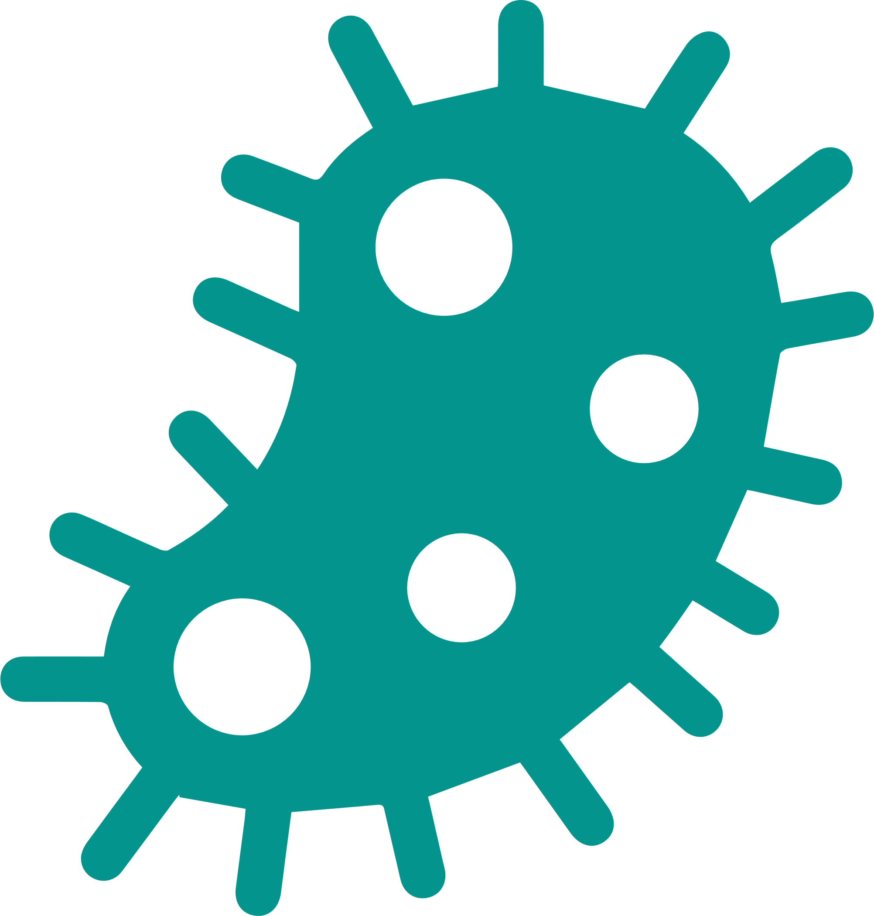


Glossary Terms
Word | Definition
Glycoprotein | A compound consisting of one or more carbohydrates and a protein.
Gut-associated Lymphoid Tissue | All the lymphoid tissue associated with the gastrointestinal tract, including the tonsils, appendix, and Peyer’s patches.
Incidence | The number of new cases of a condition, symptom, death, or injury that develops in a specific area during a specific time period.
Integrase | An enzyme found in HIV and other retroviruses. HIV uses integrase to insert its viral DNA into the DNA of the host CD4 cell, a crucial step in the HIV life cycle.
Lymphocyte | A type of white blood cell that are found in the blood, lymph, and lymphoid tissue and help the body fight infection.
Matrix | The intercellular material of a tissue.
Mucosa | Pertaining to the mucous membrane, the layer that lines body cavities and canals that open to the environment. The type of tissue varies with the function or location of the mucosa.
Parasite | Any organism that lives on or in another living organism (the host) and gets its food from or at the expense of the host.
Prevalence | The number or proportion of people with a particular disease or condition in a given population and at a specific time.
Protease | A type of enzyme that breaks down proteins into smaller proteins or smaller protein units, such as peptides or amino acids.

Slide 22




Glossary Terms
Word | Definition
Provirus | An inactive viral form that has been integrated into the genes of a host cell. When the CD4 cell replicates, the HIV provirus is passed from one cell generation to the next, ensuring ongoing replication of HIV.
Reverse Transcriptase | An enzyme found in HIV (and other retroviruses). HIV uses reverse transcriptase (RT) to convert its RNA into viral DNA, a process called reverse transcription. Non-nucleoside reverse transcriptase inhibitors (NNRTIs) prevent HIV from replicating by blocking RT.
RNA | Ribonucleic acid; one of 2 types of genetic material found in all living cells and many viruses (the other type is DNA); plays important roles in protein synthesis and other cell activities.
Virion | A complete viral particle that consists of an RNA or DNA core with a protein coat.

Slide 23
Knowledge Check
1. According to the CDC, 32,100 people (age 13 years and older) were diagnosed with HIV in the United States in 2021. Which group accounted for the majority (81%) of estimated infections?
Men
Women
Black/African Americans
People living in the southern states
2. What is a true statement about the structure of HIV? [Check all that apply.]
Each complete virus particle is called a virion
The viral envelope contains integrase on its surface
HIV is an enveloped virus that is able to infect and replicate within cells
HIV contains 25 encoded genes
3. Ways HIV is transmitted are through which of the following? [Check all that apply.]
Unprotected sexual intercourse
Saliva, sweat, or tears
Contaminated needles
Sharing food or drink

Slide 24
Knowledge Check
4. HIV mainly infects and replicates within which of the following cell types?
B cells
Skin cells
Red blood cells
CD4 cells
5. True or False: Viruses are microscopic infectious agents that requires a living host cell in order to replicate.
True
False
6. What is true about latent HIV reservoirs?
They are established during the late stage of HIV infection
They are composed of cells infected with HIV but not actively producing HIV
They can be completely eliminated with ART
They are constantly producing HIV
7. True or false? The incidence of a disease is the total number of cases of the disease present in a specified population at a given time.
True
False

Slide 25
Knowledge Check Answers
A
A, C
A, C
D
A
B
B

